Slide 1
系统设计(二)
Designing News feed System
Facebook newsfeed
你们的好朋友Eddie

Slide 2
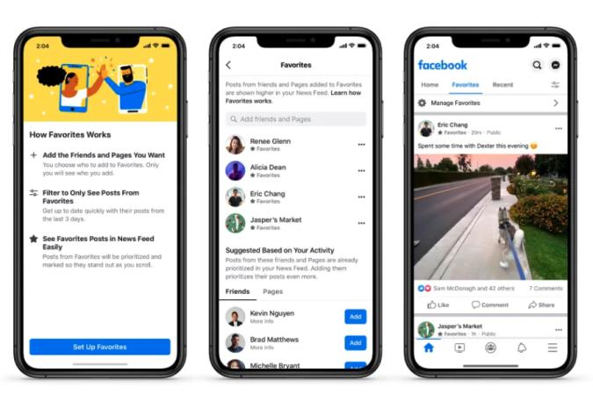
what is newsfeed?
News Feed is the constantly updating list of stories in the middle of your home page. News Feed includes status updates, photos, videos, links, app activity and likes from people, Pages and groups that you follow on Facebook.
How News Feed Works

Slide 3
Normal steps of system design
Requirement clarification
Scale of the system - data size
API interface
Database data-model
High-level design(draw a picture)
Detailed design(corner case of user user case, cache, load balance, optimize)
Bottlenecks (single point of failure, replicas of the data if lost, monitoring, alart, autofix/ticket)

Slide 4
Requirement clarification（不问问题就开始写代码？你这题一定做过，换题！或者变种！）
Eddie: 老板你这是手机app还是网页啊，还是跨平台?
面试官：both
Eddie: 你有啥重要feature要求啊(可能这步让自己想)
面试官：a user can publish a post and see her friends’ post on news feed page
Eddie: 老板有啥特殊兴趣爱好吗？啊，不是。你想按照什么优先级来排序显示newsfeed嘛？
面试官: keep it simple, just use reverse date order, latest comes first
Eddie: 不知道一个用户有多少小伙伴呢？
面试官：500
Eddie: traffic 大概得有多少呢？
面试官：guess what, you have to deal with it, I am not kidding!

Slide 5
第一步根据前面的问答我们需要确定用户的需求，我们的产品的purpose
Functional requirements: 产生朋友圈newsfeed building，看朋友圈feed publishing
1.产生信息流 generate newsfeed
2.用户可以订阅别人（这里可以展开很多，like, comment(comment on a comment IG不允许会只保存2层))
3.信息流可以文字图片视频（和票圈一样） get/store image/video/text
4.用户取信息流，在线用户及时更新 notification/publishing feed
Non-functional requirements:
对于所有用户信息流快速创建，信息流有新post 5秒内快速传送
Our system should be able to generate any user’s newsfeed in real-time - maximum latency seen by the end user would be 2s.
A post shouldn’t take more than 5s to make it to a user’s feed assuming a new newsfeed request comes in.

Slide 6
2. Scale of the system - data size
我们有300个小伙伴，我们同时订阅了200个公众号
Traffic estimates: 比如我们有30M DAU(Daily Active User), 每个用户每天刷10次手机里的newsfeed, 最后我们有300M newsfeed request 每天，换算成秒 / 86400 = 3500 每秒request
Storage estimates: 我们cache保存500个post给每个user，每个post假设简单的text占用1kb，一个用户500kb，
30M * 500 kb = 15000M kb = 15 MMB=内存15TB来做memo cache, 一个server保存100GB, 那么我们需要150台机器。

Slide 7

4. System APIs
当然parameter可以扩展
比如只要几号到几号之间的
优先级权重是什么的
最多要几个post
那些不看的（比如filter掉成人内容的）
还有一些不重要的比如加好友，订阅别人，给别人的票圈点赞评论转发，我们就都忽略了不涉及，大家自己嘴遁一下不要浪费太多时间即可
Feed publishing API
POST /v1/me/feed
Params:
content: content is the text of the post
user_id: 总得告诉server谁发的帖子吧
auth_token: 给request authentication
News feed retrieval API
GET /v1/me/feeds
Params:
auth_token
user_id
pagination

Slide 8
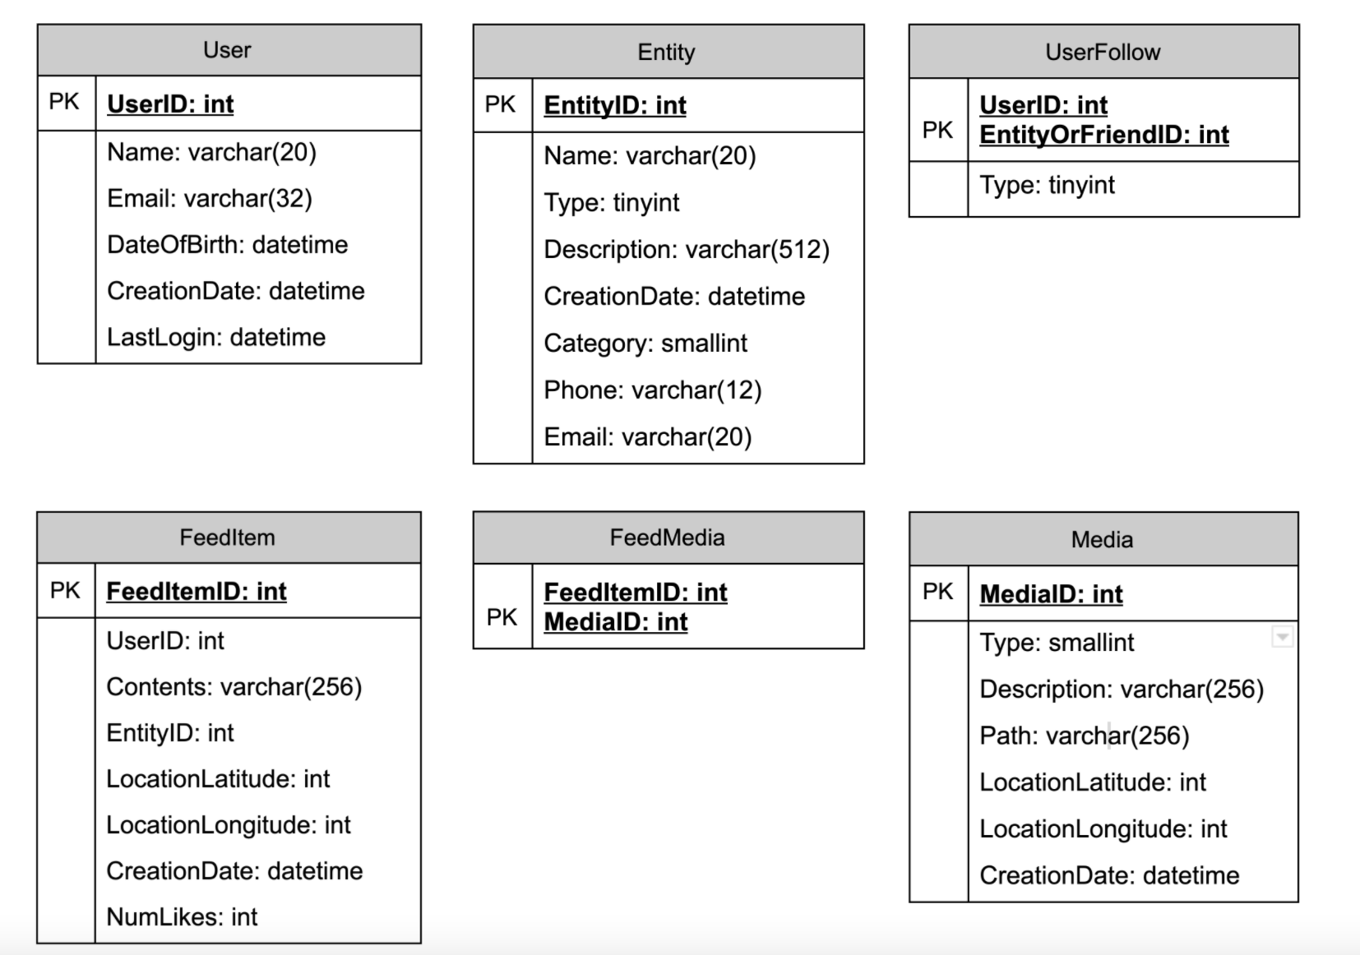
4. Database design
主内容保存在内存，disk为辅，queue来保存pushlising, 用户从queue里面来拿
User (用户) => 可以和别的用户好友，可以订阅公众号
Entity (e.g. page, group, etc.), （公众号）用户和公众号都可以发文章
FeedItem (or Post) （一篇微信公众号文章，后者一个票圈）我们加个表格记录一下是谁发的
然后还可以加like table
id, parent, userId, active, timestamp
还可以有comment table
多用户同时登录的时候，两个人同时更新。
数据库double size如何扩容
nosql来储存用户之间关系

Slide 9
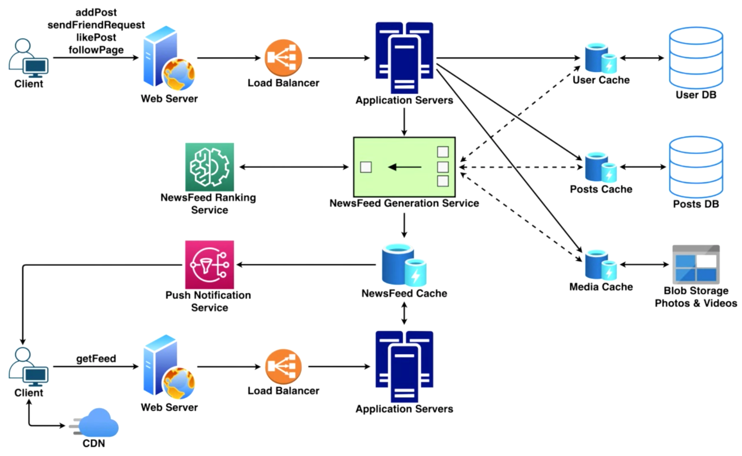
5. High-level design(draw a picture)
single point failure
replica
fanout
思路不要是cache down，因为是毁灭性的打击
Notes:
Feed generation: Newsfeed is generated from the posts (or feed items) of users and entities (pages and groups) that a user follows. So, whenever our system receives a request to generate the feed for a user (say Jane), we will perform the following steps:
Retrieve IDs of all users and entities that Jane follows.
Retrieve latest, most popular and relevant posts for those IDs. These are the potential posts that we can show in Jane’s newsfeed.
Rank these posts based on the relevance to Jane. This represents Jane’s current feed.
Store this feed in the cache and return top posts (say 20) to be rendered on Jane’s feed.
On the front-end, when Jane reaches the end of her current feed, she can fetch the next 20 posts from the server and so on.
One thing to notice here is that we generated the feed once and stored it in the cache. What about new incoming posts from people that Jane follows? If Jane is online, we should have a mechanism to rank and add those new posts to her feed. We can periodically (say every five minutes) perform the above steps to rank and add the newer posts to her feed. Jane can then be notified that there are newer items in her feed that she can fetch.
Feed publishing: Whenever Jane loads her newsfeed page, she has to request and pull feed items from the server. When she reaches the end of her current feed, she can pull more data from the server. For newer items either the server can notify Jane and then she can pull, or the server can push, these new posts. We will discuss these options in detail later.
At a high level, we will need following components in our Newsfeed service:
Web servers: To maintain a connection with the user. This connection will be used to transfer data between the user and the server.
Application server: To execute the workflows of storing new posts in the database servers. We will also need some application servers to retrieve and to push the newsfeed to the end user.
Metadata database and cache: To store the metadata about Users, Pages, and Groups.
Posts database and cache: To store metadata about posts and their contents.
Video and photo storage, and cache: Blob storage, to store all the media included in the posts.
Newsfeed generation service: To gather and rank all the relevant posts for a user to generate newsfeed and store in the cache. This service will also receive live updates and will add these newer feed items to any user’s timeline.
Feed notification service: To notify the user that there are newer items available for their newsfeed.

Slide 10
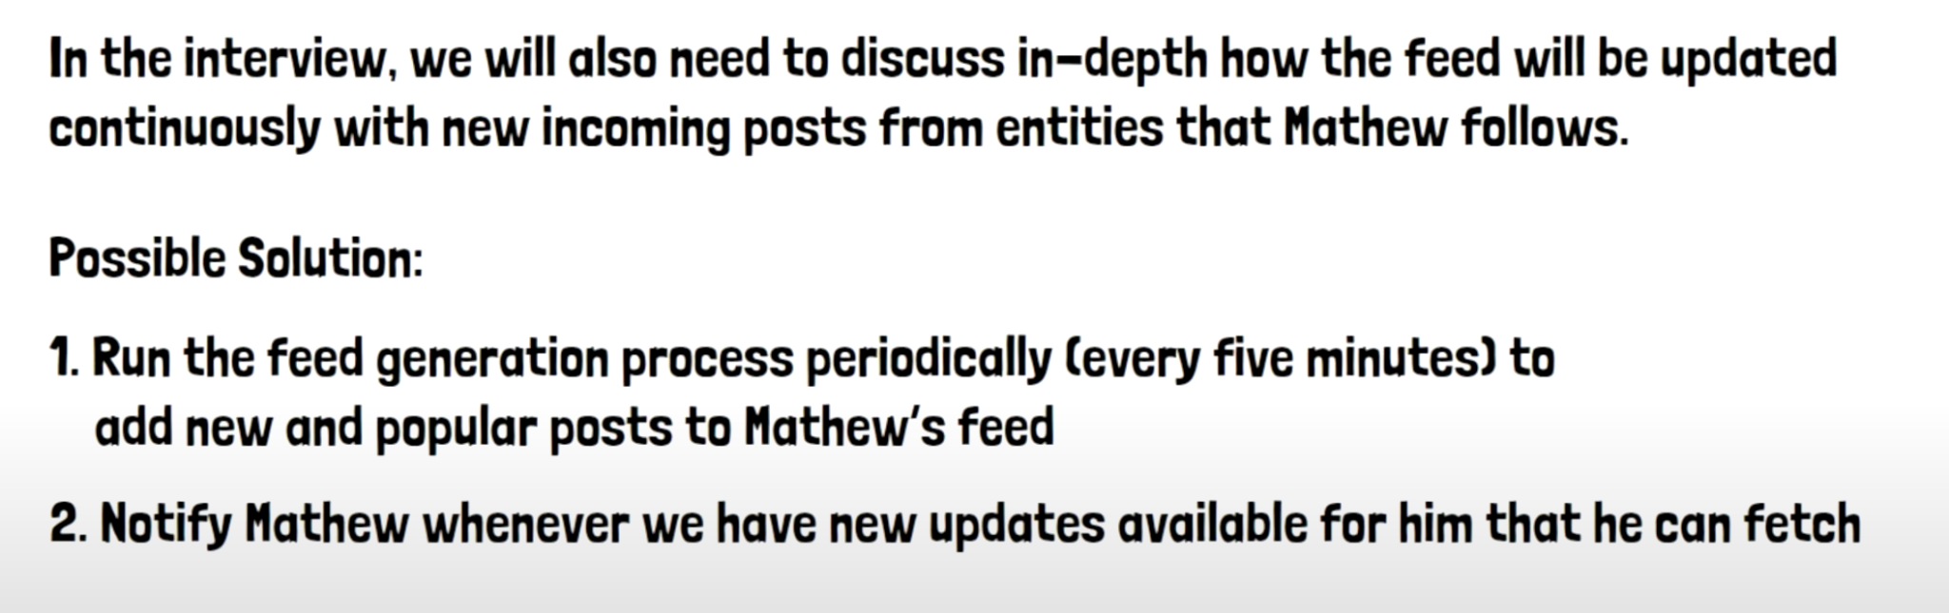
Feed generation(building):
这里每个用户的20个newsfeed可以用linkedhashmap来保存，既可以o1拿到任何一个post，又可以按照相对顺序排列，下一次读上次遗留下来的位置
把自己订阅的用户ID都拿回来
通过ID查询出他们最新的post
根据自己的喜好来post排序，必须我喜欢猫，猫在前面。
把产生出来的结果放入cache，把最新的20个posts放在newsfeed上展示
如果用户已经把这20个看完了，用户小手一抖，一个下拉再从cache里面取下一组20个
这里注意因为我们是offeline algorithm不是实时的，如果这个用户在线，同时有新的post来，我们就需要额外处理加入到这个newsfeed中

Slide 11
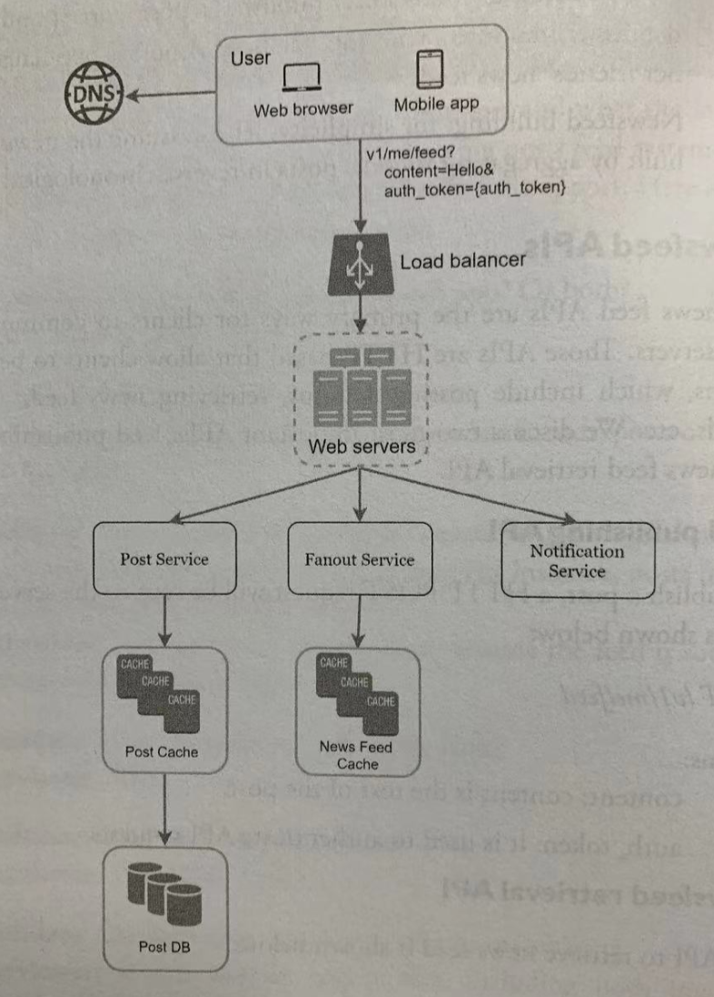

Feed publishing:
用户首次登陆，或者用户手动下拉我们来load更多的post
fanout service用来把新post发送给订阅者
这里讨论关于fanout on write vs
fanout on read
fanout process:
use graph database to get user follower ids
get user info from cache, so you can mute one you don’t like, 或者你不在对方的group里
把postId, friend list send to message queue
fanout worker 保存数据到newsfeed cache
<post_id, user _id> 有新的来就append
server这里注意
auth & rate limit

Slide 12
6. Detailed design(corner case of user user case, cache, load balance, optimize) 这个topic比较重要
"Pull" model or Fan-out-on-load: recent feed data kept in memory on server
好处：僵尸粉不登录的用户不会占用系统资源，没有明星hotkey issue
坏处：1. 数据会比较老直到下一次pull request
2.一直刷没新的post就会返回empty response, 浪费资源
"Push" model or Fan-out-on-write: 帖子写出来立马产生newsfeed, 用户需要long pulling/websocket
好处：爱豆发新帖子，粉丝立马收到。拿newsfeed更快直接push给用户, 不需要先拿爱豆id再去取文件
坏处：爱豆的粉丝太多了，一次push消耗太大，hotkey problem
Hybrid: 普通用户push model, 爱豆(celebrities) 订阅者pull model
如何结合两者，只push notication, 然后用户去点击。
我们对于爱豆的定义需要看一个range，因为粉丝的订阅可能有抖动，30k~50k才可以被认为是idol。

Slide 13
6. low level - Cache
我们不能每次都产生新的不是？
news feed (id)
content (hot cache, normal)
social graph (follower, following)
Action (liked, replied)
counters (like counter, reply counter)

Slide 14
7. Bottlenecks (single point of failure, replicas of the data if lost, monitoring, alart, autofix/ticket)
follow up:
我们应该给所有用户generate newsfeed嘛？僵尸粉不需要newsfeed
LRU cache，你不常登陆抱歉没有你的蛋糕了
神奇的machine learning model 来预测你的登陆时间，比如你经常在深夜12点打开ins看小姐姐。。那么11点就开始generate your newsfeed

Slide 15
follow up about notification and ranking
关于notification也可以展开很多
用户应该可以选择是否有notification（如何保证信息delivery到）
手机端如果流量有限是否不是自动更新需要手动pull？电脑端push等
明星粉丝的熟练是变化的
关于feed ranking system
另外一个系统综合用户的喜好，之前的每个post停留时间，那个明星likes多，那个广告爸爸给的钱多，(这里设计到ads是另外一个话题，每次明星的post其实还push到一些分类，比如20岁，小鲜肉，选秀，然后订阅者hashtag的用户或者属于这些年龄层的用户就成了traget，会被塞入ads)

Slide 16

常规follow up 无限剑制
scaling database
vertical vs horizontal
sql vs nosql
master-slave replicas
consistency models
database sharding
keep web tier stateless
hotkey festival special case handle

Slide 17
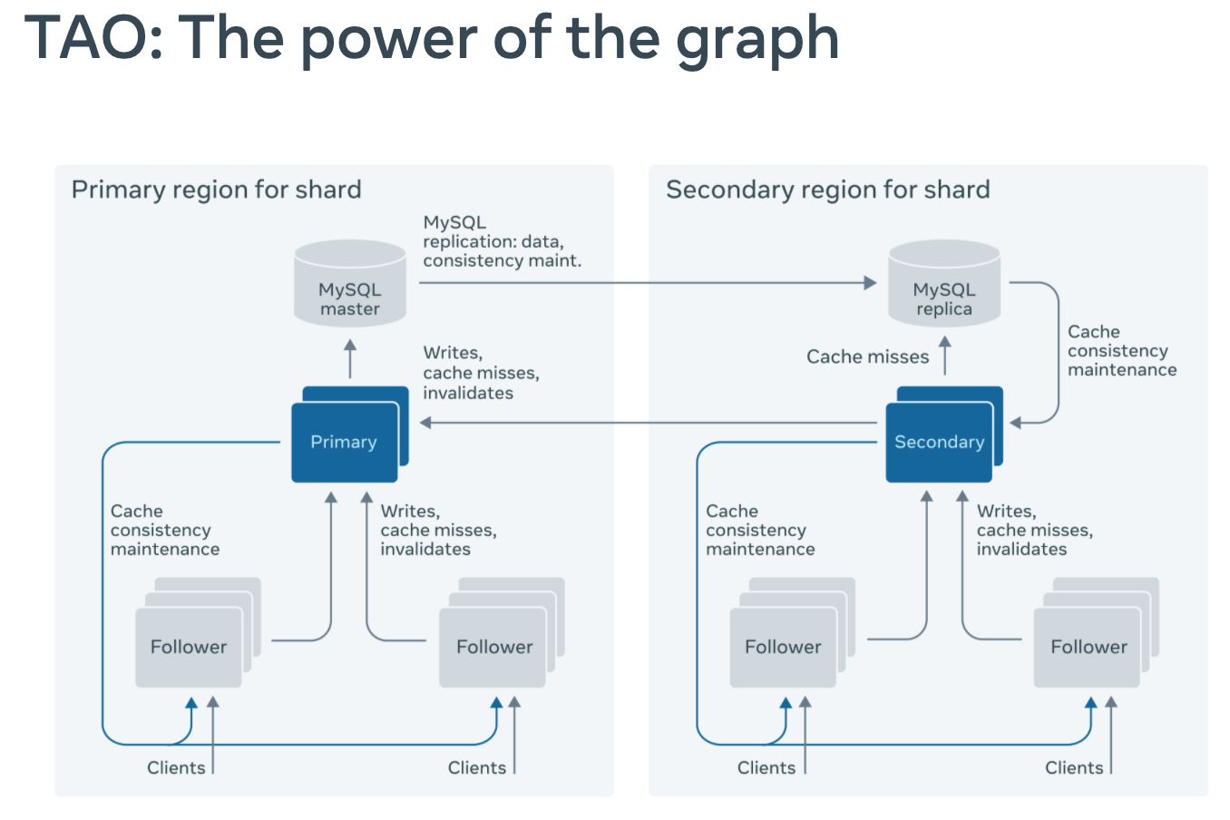
Facebook database
Instagram -> Apache Cassandra (NoSql)
Facebook -> Tao(cache layer) UDB
Next TAO: The power of the graph UDB = User Data Base (MySQL)
有一些无强consistence的情境也使用
KV Store

Slide 18


通讯页面
Bilibili https://space.bilibili.com/21630984
Youtube 搜索古城算法
https://www.youtube.com/c/古城算法
wechat 回复‘加群’可加群
谢谢大家的支持！请点赞订阅硬币
500订阅会出一期dp总结篇
免费，不要钱，不卖课，不推销，不辅导，公开资料和视频，任何人和你说钱都是骗子！

Slide 19
reference
DESIGN FACEBOOK NEWS FEED | INSTAGRAM | TWITTER | Facebook System Design Interview Series
Mock Interview: design facebook feeds
DESIGN FACEBOOK NEWS FEED | INSTAGRAM | TWITTER | Facebook System Design Interview Series
Designing Instagram: System Design of News Feed
book: System design interview Alex Xu

